Slide 1

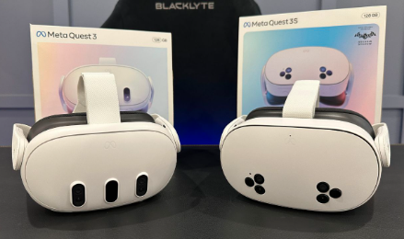
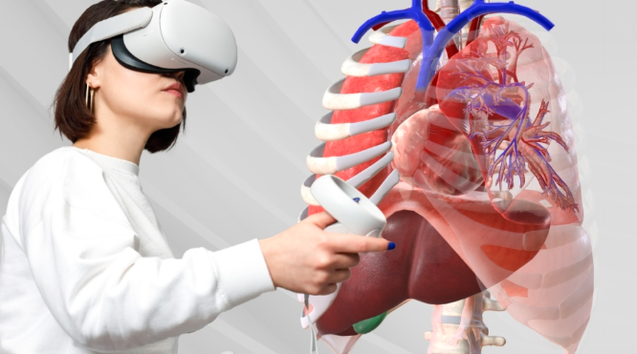
Immersive Learning with AR/VR Technologies
Dr. Nazia Ejaz (Chairperson BMED)
and
Dr. Wazir Muhammad (Assistant Professor BMED)

Slide 2
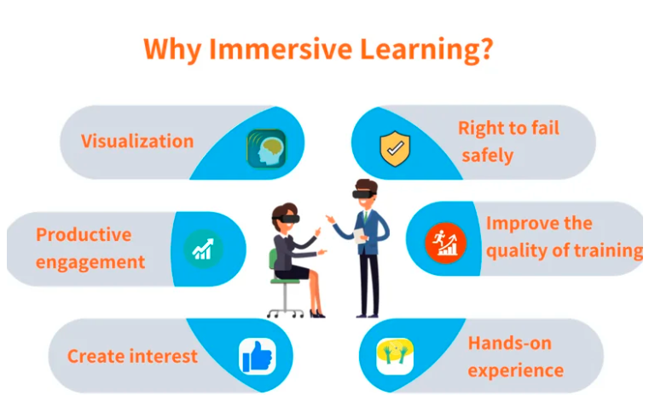
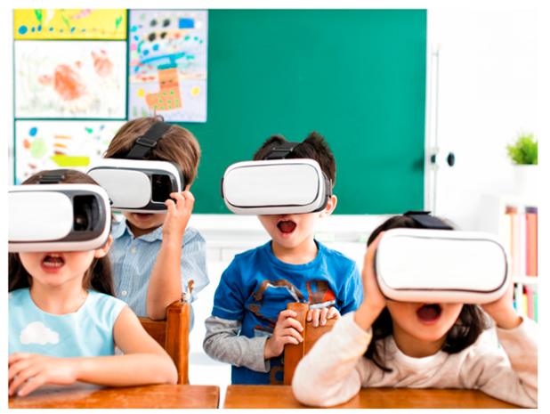
Immersive learning
Immersive learning is an experiential educational approach that fully engages learners by placing them in simulated, realistic environments, often using technologies like virtual reality (VR), augmented reality (AR), or interactive simulations.

Slide 3
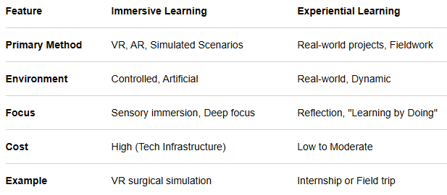
Difference between Immersive learning vs Experiential learning

Slide 4
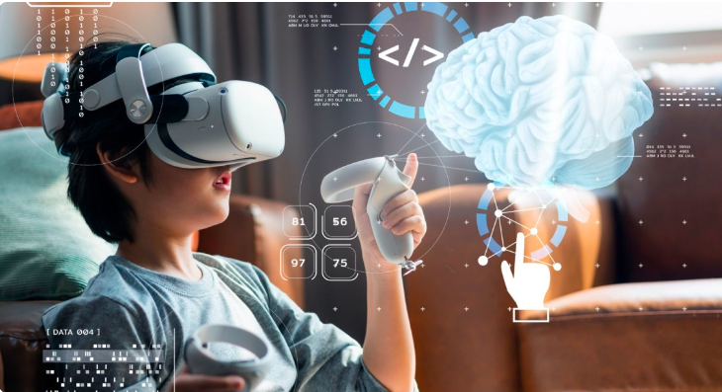

Virtual Reality (VR)
Virtual Reality (VR) is a computer-generated, 3D simulated environment that immerses users through sensory devices like headsets, gloves, and sensors.
It enables real-time, interactive experiences for gaming, training, healthcare, and education.
Key features include 360-degree views, motion tracking, and, sometimes, haptic feedback

Slide 5
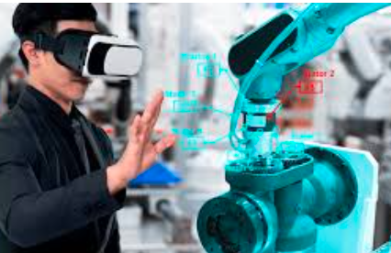
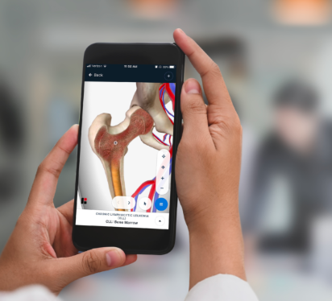
VR Versus AR
Immersion Level: VR offers total immersion, blocking out the physical world. AR is partially immersive, with digital elements added to the user’s real-world view.
Environment: VR creates a 100% virtual, computer-generated world. AR blends virtual objects into the existing, physical environment.
Hardware: VR requires specialized, enclosed headsets. AR is often accessed via smartphones, tablets, or smart glasses.
Purpose: VR is ideal for simulations, training, and gaming. AR excels in providing real-time information, navigation, and interactive, superimposed visuals.
Examples:
VR: Gaming headsets (Meta Quest), simulation training, virtual tours.
AR: Snapchat filters, Pokémon Go, IKEA Place app

Slide 6
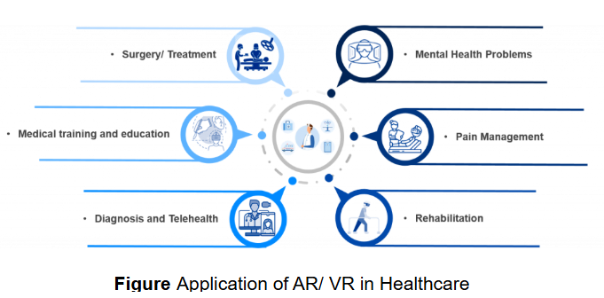

Slide 7
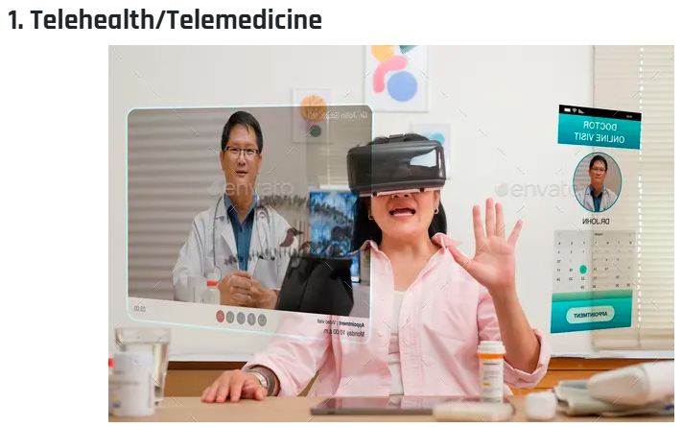

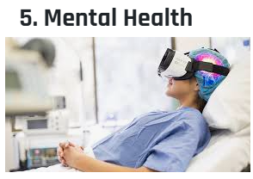
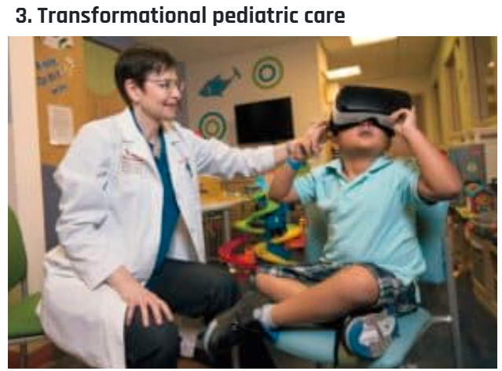
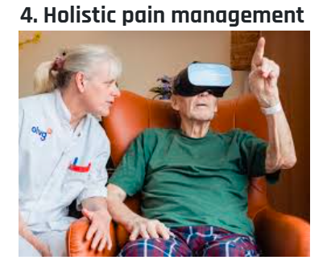
How is VR in healthcare improving treatments and outcomes?

Slide 8
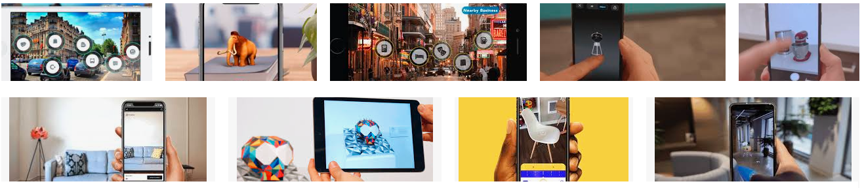
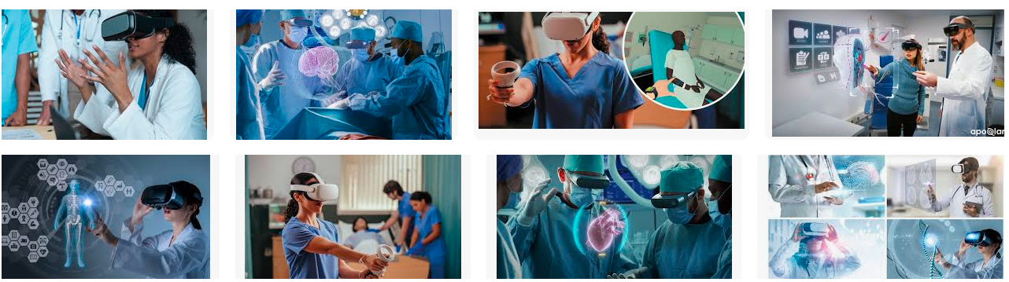
Observe AR And VR Technologies

Slide 9
https://xrlabsys.netlify.app/
https://xrlabsys.netlify.app/#video-section

